Slide 1
Graham Clinning capstone assignment presentation

Slide 2
Introduction
The idea is to identify the neighbourhoods in the Bronx and York, to identify the top 5 venues per neighbourhood and to show them on a map so that people can see where they are located.

Slide 3
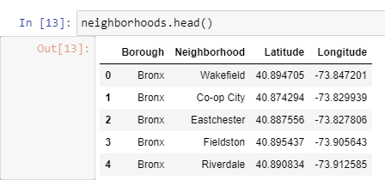
New York data

Slide 4
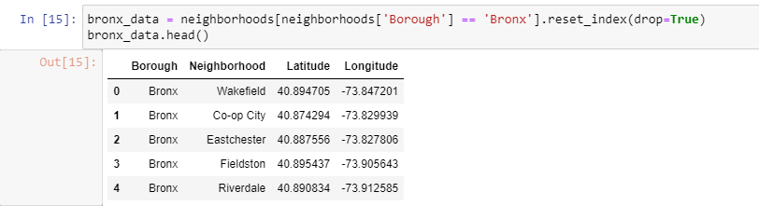
New York data converted to the Bronx data frame

Slide 5
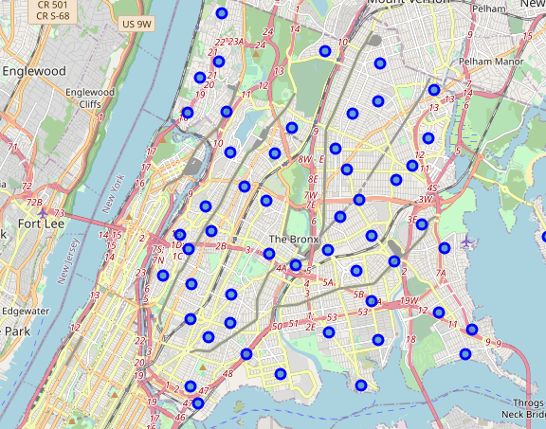
Folium map of the Bronx

Slide 6
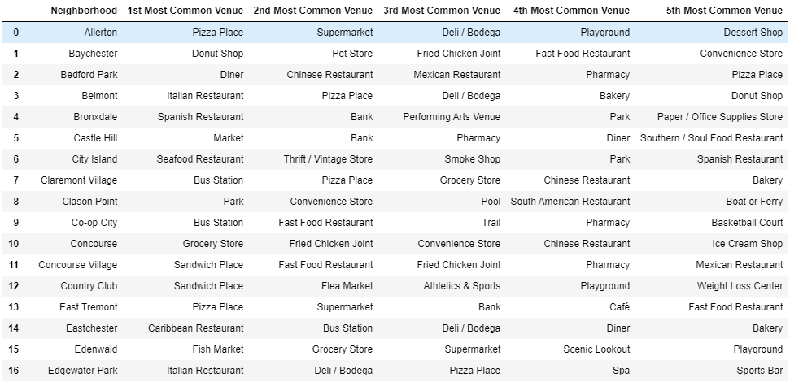
Top 5 venues for neighbourhoods in the Bronx

Slide 7
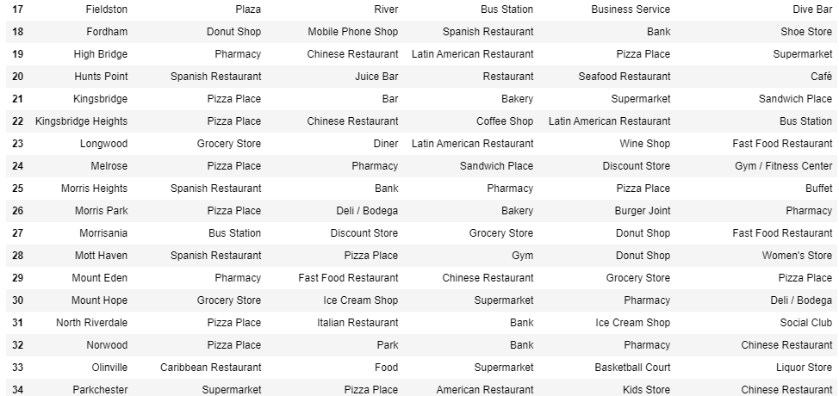
Top 5 venues for neighbourhoods in the Bronx – cont.

Slide 8
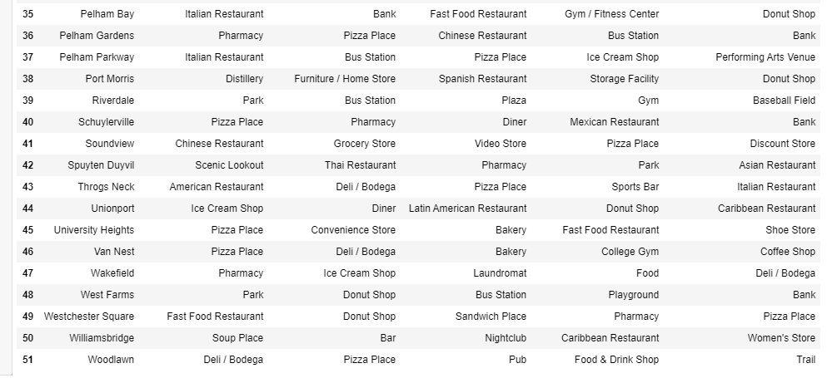
Top 5 venues for neighbourhoods in the Bronx – cont.

Slide 9
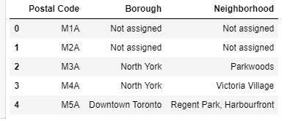
Canada data

Slide 10
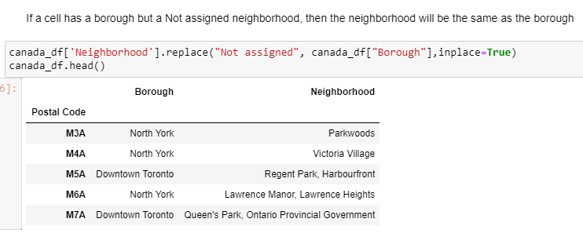
Canada data - cleaning

Slide 11
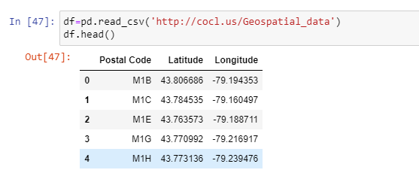
Canada data – adding In longitude and latitude

Slide 12
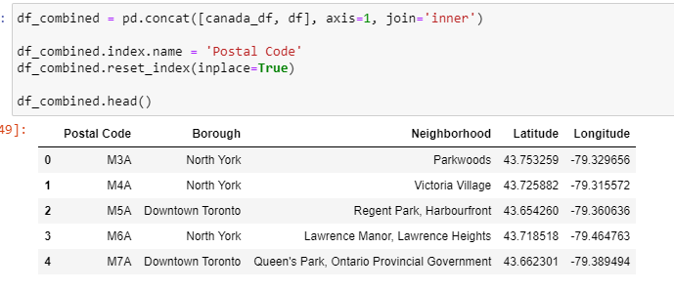
Canada data – combining data frames to make one usable version

Slide 13
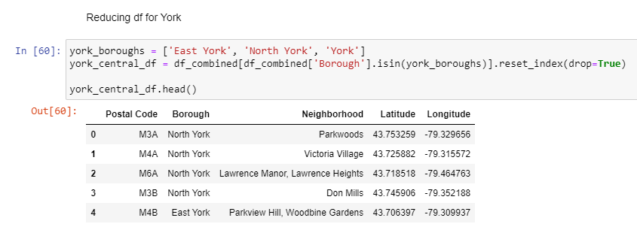
York data – making data frame only for York

Slide 14
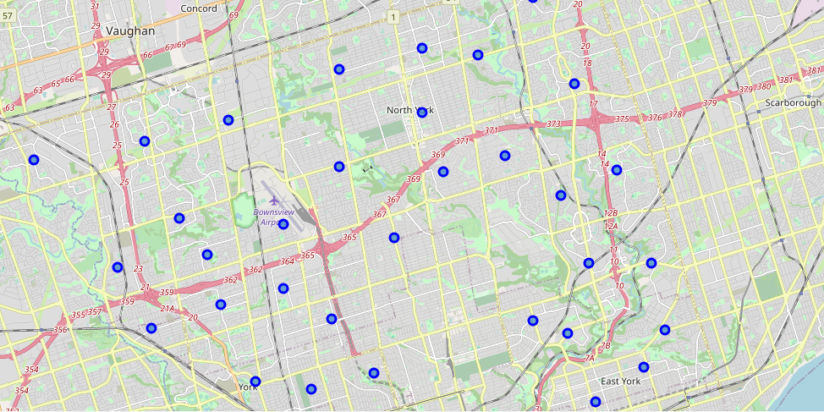
York data – folium map

Slide 15
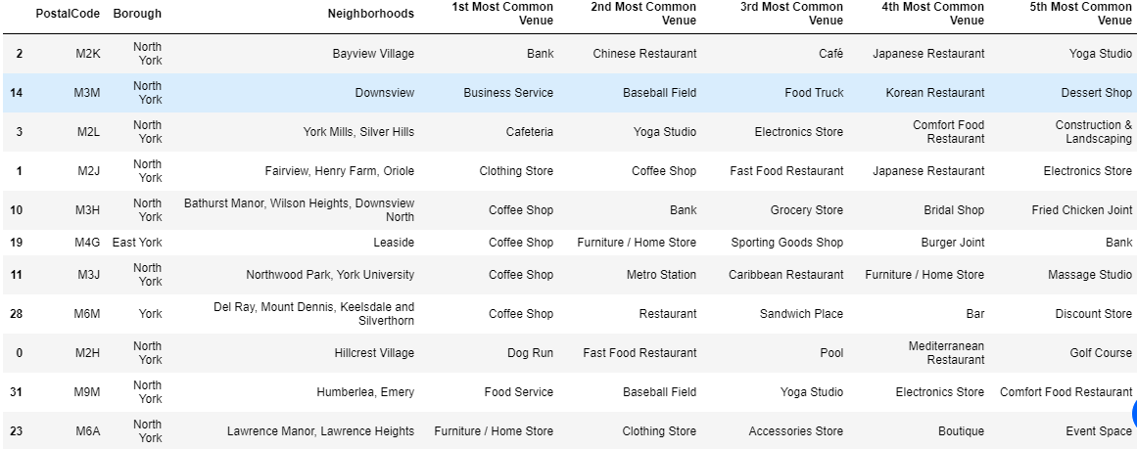
Top 5 venues for neighbourhoods in York

Slide 16
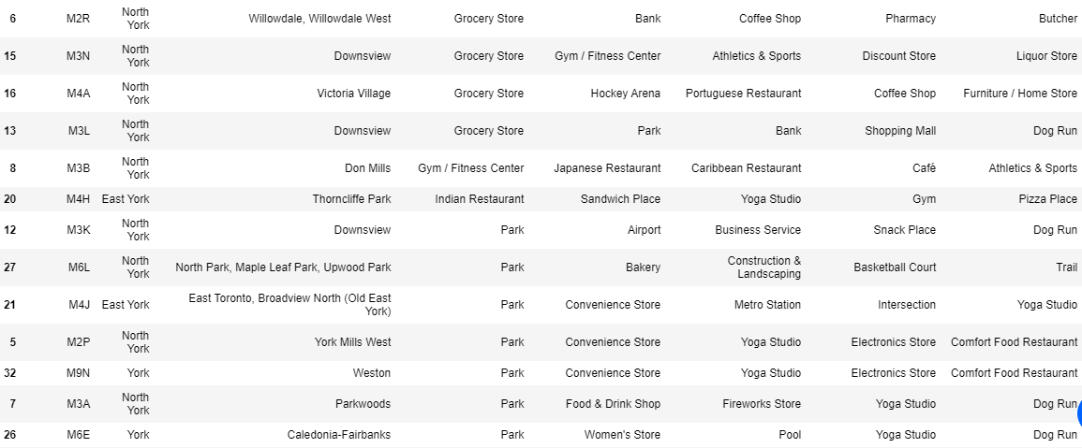
Top 5 venues for neighbourhoods in York – cont.

Slide 17
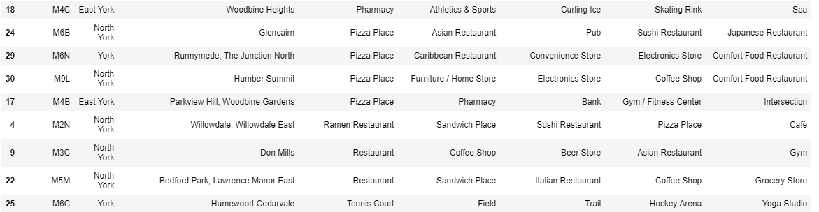
Top 5 venues for neighbourhoods in York – cont.

Slide 18
Conclusion
As identified in the problem, we have created a list of the top 5 venues per neighbourhood in the Bronx and York.
We have also shown a folium map of the neighbourhoods in the Bronx and York.
People can now be happy with the insights on where they an go and what they can do in both boroughs.

